Slide 1
Digital Dispute Resolution in England and Wales
Ivan Philippov

Slide 2
Introduction
Digital technology revolution in arbitration
Demand for use of digital technology in arbitration
2020 update of LCIA Arbitration Rules – embracing digital technology
Remote hearings in English courts

Slide 3
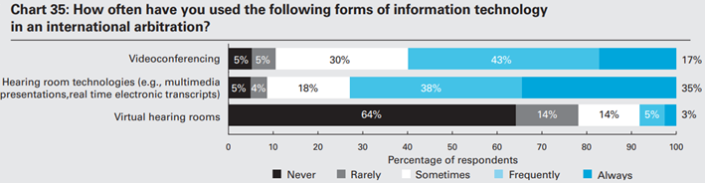
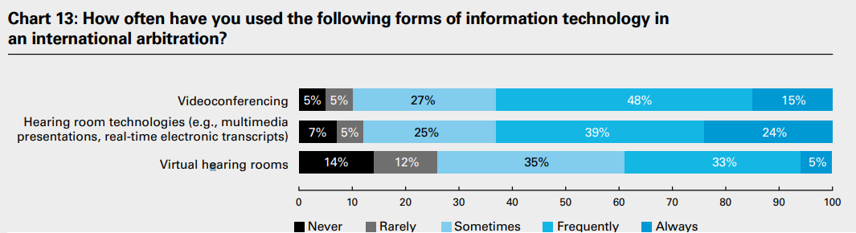
Digital Technology Revolution in Arbitration
2019 W&C and Queen Mary Arbitration Survey
2021 W&C and Queen Mary Arbitration Survey

Slide 4
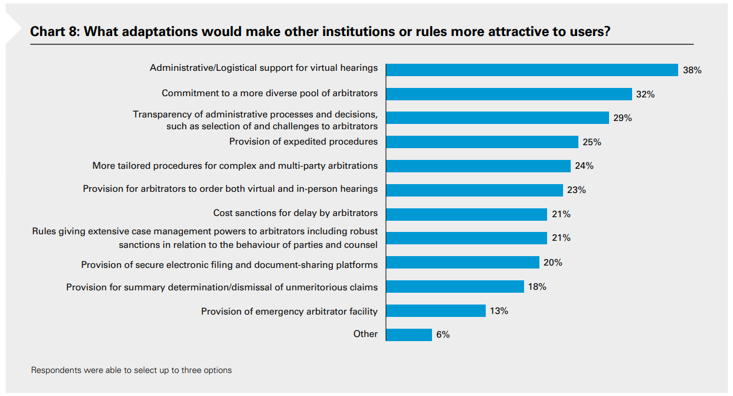
Demand for Use of Digital Technology in Arbitration (1)
2021 W&C and Queen Mary Arbitration Survey

Slide 5
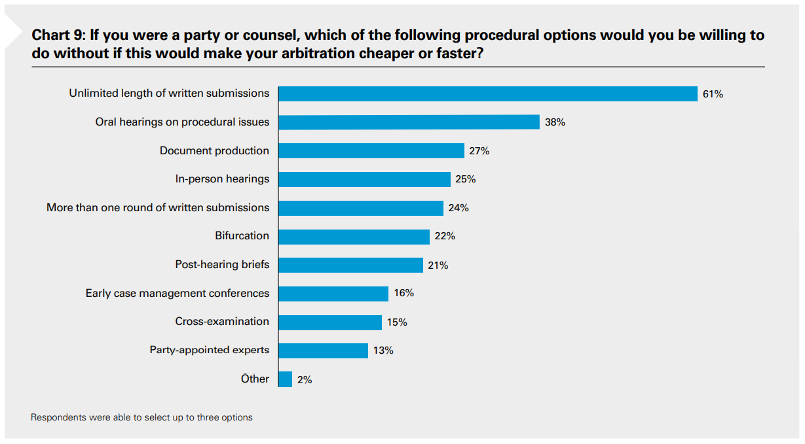
Demand for Use of Digital Technology in Arbitration (2)
2021 W&C and Queen Mary Arbitration Survey

Slide 6
2020 Update of LCIA Arbitration Rules – Embracing Digital Technology
2020 LCIA Arbitration Rules came into force on 1 October 2020 and apply to any LCIA arbitration commenced from that date.
Primacy of electronic communication, electronic awards and signatures (Article 4.1, Article 4.2 and Article 26.2).
Article 19.2: “As to form, a hearing may take place in person, or virtually by conference call, videoconference or using other communications technology with participants in one or more geographical places (or in a combined form)”.
Breadth of Article 19.2 affords flexibility to decide upon format of hearings and may insulate against attempts to challenge awards based on the format of hearing used.

Slide 7
Remote Hearings in English Courts (1)
March 2018: first video hearing pilot launched in first tier tax tribunals in Birmingham and Manchester.
December 2018: although most of hearings experienced technical difficulties, the pilot was declared a success.
March 2020: COVID-19 pandemic led to radical and swift transition to remote technology, speeding up existing plans to digitise the courts.
July 2020: the Government introduced specialised Cloud Video Platform.

Slide 8
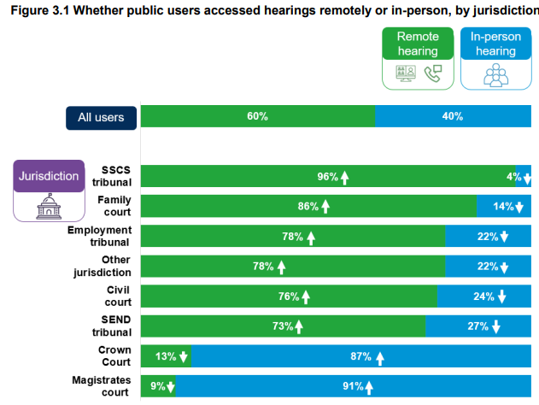
Remote Hearings in English Courts (2)
December 2021 Government Report

Slide 9
Remote Hearings in English Courts (3)
Courts and tribunals are open for hearings and face coverings are not mandatory.
Some shorter hearings (varies, 1 hour in King’s Bench Division, half a day in Commercial Court) usually take place remotely.
Longer hearings are usually in person, unless there is particular reason to request a remote or hybrid hearing.
Ultimately, the decision as to whether a hearing will take place remotely or be a hybrid hearing is for the judge.

Slide 10
Questions?

